Slide 1
Software Architecture and Design I SOEN 343 Instructor: Dr. Rodrigo Morales https://moar82.github.io/ rodrigo.moralesalvarado@concordia.ca
Lecture 11 part 2: DATA CENTERED SOFTWARE ARCHITECTURE
Ch 6. Textbook:
Software architecture and design illuminated / Kai Qian ... [et al.]
Publisher Sudbury, Mass. : Jones and Bartlett Pub., c2010.
Notes:
1

Slide 2
Objectives
• Introduce the concepts of data centered software architecture
• Describe the repository and blackboard architectures
• Discuss applicable domains for data centered software architecture
• Discuss the benefits and limitations of data centered software architecture
• Discuss the data centered architecture when incorporated with other architectures

Slide 3
Overview
The data centered software architecture is characterized by a centralized data store which is shared by all surrounding software components
The software system is decomposed into two major partitions: data store and independent software component or agents
The connections between the data module and the software components are implemented either by explicit method invocation or by implicit method invocation

Slide 4
There are two categories of data centered architecture: repository and blackboard
These are differentiated by the flow control strategy
The data store in the repository architecture is passive and clients of the data store are active; that is, clients (software components or agents) control the logic flow
Clients may access the repository interactively or by a batch transaction request

Slide 5
The data store in the blackboard architecture option is active and its clients are passive; thus, the flow of logic is determined by the current data status in the data store
The clients of a blackboard are called knowledge sources, listeners or subscribers

Slide 6
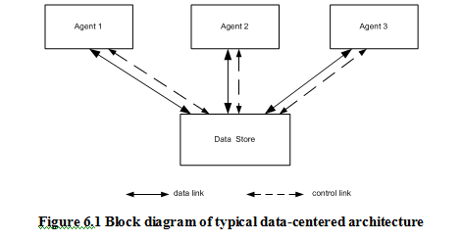
Block diagram of typical data-centered architecture

Slide 7
Repository Architecture Style
The repository architecture style is a data centered architecture that supports user interaction for data processing (as opposed to the batch sequential transaction processing discussed earlier)
The software component agents of the data store control the computation and flow of logic of the system

Slide 8
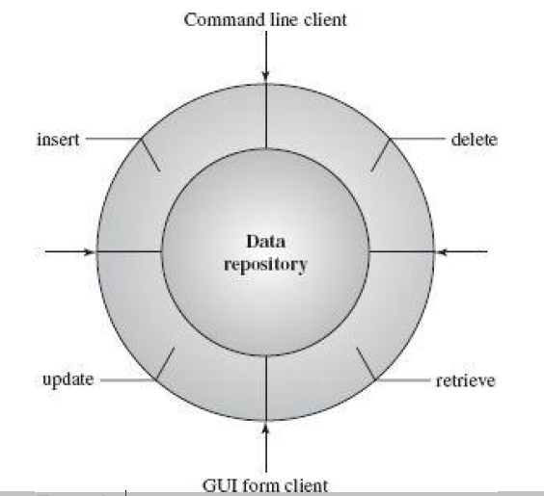
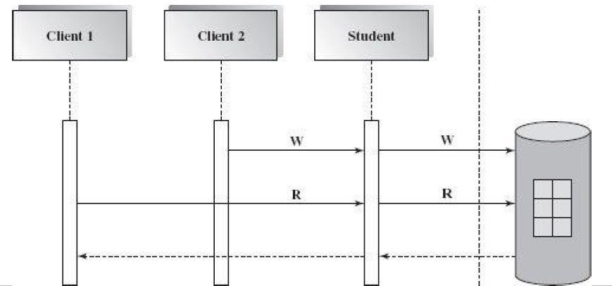
Sequence diagram of repository architecture
DB system
Notes:
SDD to the right depicts a dynamic view of this repository architecture. It indicates that one instance object can be shared and accessed by multiple clients with reading and writing for search, update, insertion, and deletion. The clients can access the same data with command line interface, GUI interface, program interface, Remote Procedure Call interfaces (RPC), or object-oriented Remote Method Invocation (RMI).
The relational database management system is a typical design domain for the repository architecture. The data store of the repository maintains all types of data including schema (metadata), data tables, and index files for data tables. Many tools are available to develop applications on the database stored in the database management system. These include design, development, maintenance, and documentation tools. Oracle Designer, Oracle Developer (Form, Graphics, and Reporter), Oracle SQL and PL/SQL, Oracle Financials, Oracle e-Business, Oracle data warehouse, and many other software tools are available for Oracle database system.
The diagram to the right shows a typical database system with its data repository.

Slide 9
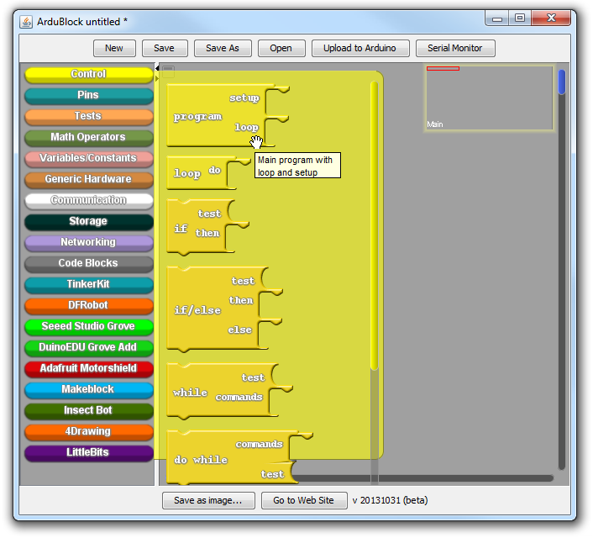
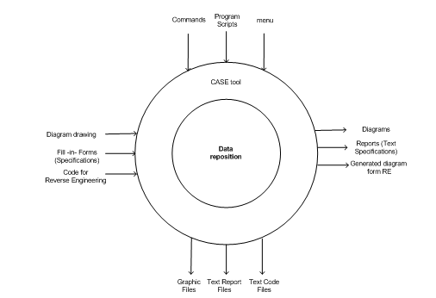
CASE system
Examples of CASE tools:
IBM Rational Software Architect
Ardublock for visually programming Arduino circuits
Notes:
A Computer Aided Software Engineering (CASE) system is another popular application domain for the repository software architecture. There are many CASE tools surrounding the data store in Figure above. A user of CASE tools can draw a UML design diagram such as a class diagram, collaboration diagram, or sequence diagram. These UML diagrams can then be converted from one format to another. Java or C++ skeleton code can also be generated based on these UML diagrams. If there is code without the original design diagram, the UML diagram can still be regenerated by reverse engineering tool. There are many other input formats available for design and many output formats, as well.
The biggest advantage of CASE tools is its centralized data with many supporting software tools which can generate different products
for different purposes based on the same set of data.

Slide 10
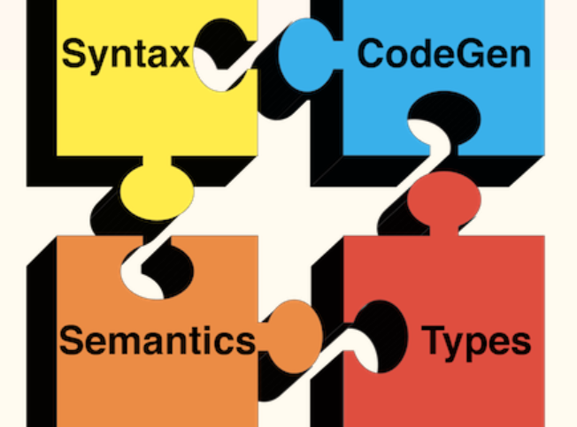
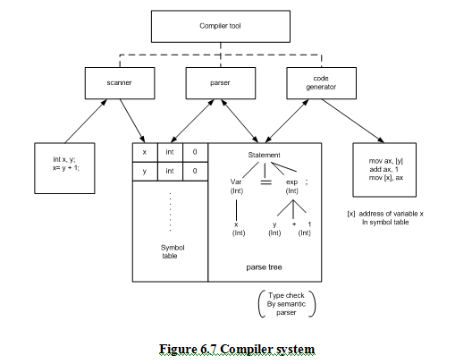
Compiler system
Notes:
Compiler construction is another good example of the repository architecture design. Every compiler system has its own reserved keyword table, identifier symbol table, constant table generated after lexical analysis, and syntax and semantics trees generated by syntax and semantics analysis. These tables' data structure in memory is shared by all phases of the compilation. Each phase will
generate new data or update the existing data in the data repository. The flow control is controlled by a program which takes a source code as its input, then goes through each phase step by step, and finally produces the target binary code which is either executable or interpretable, such as Java bytecode. In other words, all agents in a repository system are not necessarily completely independent.
There is a logical order in the executions of all compilation phases. There may still be some communication between individual agents.
For example, the lexical analysis may find some unacceptable characters, so that the compilation must be abandoned and compile
In the picture to the right, the scanner takes two lines of an int type variable declaration and an assignment statement. The lexical analyzer (scanner) tokenizes all input entities and puts them in the symbol table used by the syntax analyzer (parser) to build a syntax tree based on the grammar.
This syntax tree is checked again by the semantics analyzer (not shown) and is also used by the code generator to produce the target code. We can see that the data in memory are shared by all agents and that the agents don't pass on data to each other directly.

Slide 11
Applicable Domain of Repository Architecture
Suitable for large complex information systems where many software component clients need to access it in different ways
Data transactions to drive the control flow of computation
Benefits:
Data integrity: easy to backup and restore
System scalability and reusability of agents
Reduce the overhead of transient data between software components
Notes:
Suitable for large complex information systems where many software component clients need to access it in different ways
Data transactions to drive the control flow of computation
Benefits:
Data integrity: easy to backup and restore
System scalability and reusability of agents: easy to add new software components because they do not have direct communication with each other
Reduce the overhead of transient data between software components

Slide 12
Limitations
Data store reliability and availability is a very important issue
High dependency between data structure of data store and its agents
The changes of data structure have significant impacts on its agents
Overhead cost of moving data on network if data is distributed
Notes:
Data store reliability and availability is a very important issue Centralized repository is vulnerable to failure compared to distributed repository with data replication
High dependency between data structure of data store and its agents
The changes of data structure have significant impacts on its agents. The data evolution is more difficult and expensive
Overhead cost of moving data on network if data is distributed

Slide 13

Blackboard Architecture Style
Notes:
The word blackboard comes from classroom teaching and learning
Teacher and students can share data in solving a problem on the classroom via a blackboard
Students and Teacher play the role of agents to make their contributions to the problem solving
They all can work in parallel and very independently
They will try their best to work together to find the best solution
The idea of blackboard architecture is similar to the classroom blackboard setting used in solving problems without deterministic outcome

Slide 14
Blackboard components
Blackboard
Knowledge sources
Controller
Used to store data
Domain-specific knowledge is stored
Used to initiate the blackboard and knowledge sources
Notes:
It is a data-directed and a partially data-driven architecture
The whole system is decomposed into two major partitions
One partition, called the blackboard, is used to store data (hypotheses and facts), while the other partition, called knowledge sources, is where the domain-specific knowledge is stored
There may be a third partition called the controller that is used to initiate the blackboard and knowledge sources, takes a bootstrap role and overall supervision control

Slide 15
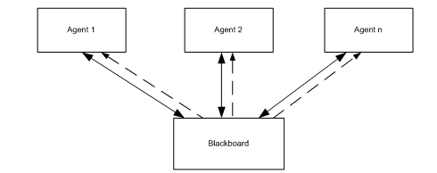
Blackboard architecture
Notes:
Figure illustrates a block diagram of the blackboard architecture. The solid lines indicate data links, while dashed lines represent
the flow logic control, which is controlled by any data changes in the data store. That is, the data in the blackboard store directs the flow
of the computation.
The connections between the blackboard sub-system and knowledge sources are basically implicit invocations from the blackboard to specific knowledge sources, which are registered with the blackboard in advance
Data changes in the blackboard trigger one or more matched knowledge source to continue processing
Data changes may be caused by new deduced information or hypotheses results by some knowledge sources
This connection can be implemented in publish/subscribe mode
Many domain specific knowledge sources collaborate together to solve a complex problem such as pattern recognition or authentication in information security
Each knowledge source is relatively independent from other knowledge sources
They don’t need to interact with each other, which is very similar to a repository system
They only need to interact and respond to the blackboard sub-system
Each source only works on a specific aspect of the problem, and contributes a partial solution to the ultimate solution

Slide 16
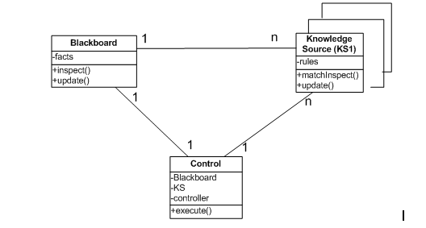
Class diagram of blackboard architecture
Notes:
Figure above shows a UML class diagram of a rule-based blackboard software architecture. As we can see, one blackboard may have many knowledge sources associated with it, working on given data and deduced data available in the blackboard subsystem. Each knowledge source helps to solve problems in its expertise area. Knowledge can be stored in different knowledge representation
formats depending on the reasoning strategy. For example, a knowledge source stores all related rules and provides activation mechanisms for the blackboard to trigger in rule-based expert system. Of course, knowledge sources must register themselves with the blackboard so that if any change takes place in the blackboard, they will be notified to fire up actions in the corresponding knowledge sources, which can deduce new facts and update the blackboard. Each individual knowledge source may have its own problem-solving strategy and use its own knowledge expertise to contribute to a partial solution which will lead to a final solution. The blackboard class holds the current data state, and the final problem solution will be placed in the blackboard for the controller to pick up and use to generate a final report. The rule-based strategy is one of many reasoning algorithms in use today. There are many other problem solving strategies that can be applied including Fuzzy set theory, probability and statistics, neural network, data mining, and heuristic searching.

Slide 17
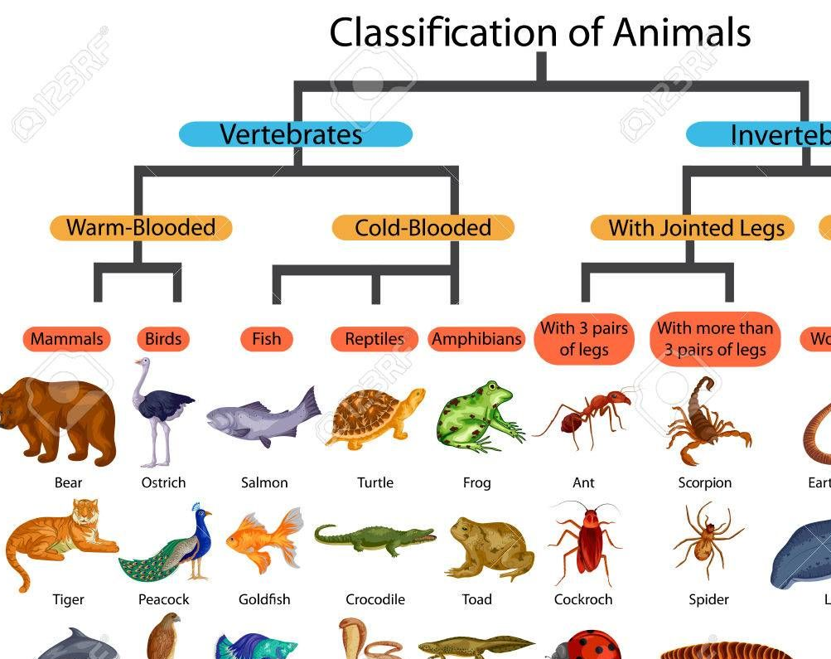
Example: animal identification knowledge-based system (KBS)
Notes:
Let’s take a look at a well-known animal identification knowledge-based system (KBS)
The knowledge is represented in the format of production rules with condition and action parts
For each rule, if the condition is true then the action is taken
The action is to put new conclusion data in the data store, which is the blackboard

Slide 18
Forward Reasoning
The forward reasoning starts with the initial state of data and proceeds towards a goal
It may reach the given goal, or it may fail to reach the goal
If the goal is not given, the reasoning will come to a point where no more new facts can be derived that indicated that is the best result we can get
Notes:
While this is a relatively simple example, it tells us how the knowledge is used in reasoning. In a more realistic blackboard system,
there are many knowledge resources, each with its own knowledge representations and reasoning algorithms

Slide 19
Example
Here is a set of rules:
R1: IF animal gives milk THEN animal is mammal
R2: IF animal eats meat THEN animal is carnivore
R3: IF animal is mammal AND animal is carnivore AND animal has tawny color AND animal has black stripes THEN animal is tiger

Slide 20

Example
set of rules
set of facts
R1: IF animal gives milk THEN animal is mammal
R2: IF animal eats meat THEN animal is carnivore
R3: IF animal is mammal AND animal is carnivore AND animal has tawny color AND animal has black stripes THEN animal is tiger
F1: animal eats meat
F2: animal gives milk
F3: animal has black stripes
F4: animal has tawny color
Notes:
Let’s follow the forward reasoning sequence. F1 matches the condition of R2 and “animal is carnivore” is derived and stored in the blackboard
If the algorithm checks the newest generated data first, the new fact does not match any rules, and then checks F2 which matches the condition of R1, and “animal is mammal” is derived and stored in the blackboard
After this point there is no single fact that matches any rule and if combined data are used the R3 is matched, and “animal is tiger” is derived and put back in the data store

Slide 21
Applicable Domain of Blackboard Architecture:
Suitable for solving open-ended and complex problems such that artificial intelligence (AI) problems where no deterministic solutions exist
The problem spans multiple disciplines, each of them has complete different knowledge expertise and problem solving paradigms that co-operation is a must

Slide 22
Partial, or approximate solution is acceptable to the problems
Exhaustive searching is impossible and impractical since it may take forever because available knowledge and even data and hypotheses may not complete or precisely accurate

Slide 23
Blackboard Benefits
Scalability: easy to add new knowledge source or update existing knowledge source
Concurrency: all knowledge sources can work in parallel since they are very independent of each other
Supports experimentation for hypotheses
Reusability of knowledge source agents

Slide 24
Blackboard Limitations
Tight dependency between the blackboard and knowledge source
Difficult to decide when to terminate reasoning, since only partial or approximated solutions are expected
Synchronization of multiple agents is an issue
Debugging and testing of the system is a challenge
Notes:
Tight dependency between the blackboard and knowledge source, the structure change of the blackboard may have a significant impact on all its agents
Difficult to make a decision when to terminate reasoning, since only partial or approximated solutions are expected
Synchronization of multiple agents is an issue. Since multiple agents are working and updating the shared data in the blackboard simultaneously, the preference or priority of executions of multiple agents must be coordinated
Debugging and testing of the system is a challenge

Slide 25
Summary 1/2
The data centered repository architecture may be one of the most popular software architectures since most of software application needs to have a data repository
Repositories are often used in layered architecture, client/server architecture, data tier in multi-tier architecture, and many other architecture designs
Agents of the data store in data centered repository architecture control the logic flow
The data store is passive in the repository architecture and agents control and trigger all operations on the data store

Slide 26
Summary 2/2
The data centered blackboard architecture is a knowledge-based architecture where the status of the data in the data store controls and triggers most of operations
The data store is active in the blackboard software architecture
The connection between the components in the blackboard architecture is implemented implicitly instead of explicit invocation in the repository systems
There are many expert systems for pattern recognition, voice or speech recognition, or other similar systems with this architecture

